Slide 1




Crime against Children Data Analysis Source: : https://www.data.gov.in/resource/district-wise-number-crime-against-children-during-2022 Dataset:District_Wise_crimes_against_children Email: kandulasirichandana0@gmail.com Phone : 8520988157 LinkedIn : linkedin.com/in/sirichandana- kandula-864224312
Crime Data Analysis Using PySpark
Kandula Siri Chandana

Slide 2
Introduction
This presentation provides an analysis of the Crimes Against Children dataset using PySpark, covering:
Dataset Structure and Uniqueness
State and District-wise Crime Distribution
Category-wise Crime Breakdown
Trend Analysis and Comparative Insights
Identification of High-Risk Regions
Correlation among Crime Factors
Key Findings and Preventive Recommendations

Slide 3
Initial Analysis of the Dataset
The dataset provided contains district-level records of crimes against children collected from the National Crime Records Bureau (NCRB) across various Indian States and Union Territories. It provides information on different categories of crimes such as Murder, Kidnapping, Foeticide, Human Trafficking, Cyber Crimes, and other IPC and SLL violations. The dataset serves as a valuable resource for crime pattern analysis, predictive modeling, and public safety insights. Below are the detailed insights:
1. Structure and Uniqueness
The dataset comprises approximately 970 rows and 72 columns, covering every district under multiple states and UTs. Each record corresponds to a unique district entry under a specific state. The dataset ensures no missing values, and each crime category is represented as a numeric attribute, providing consistency for quantitative analysis. This structure allows for scalable state-wise and district-level aggregation.
2. Crime Categories
There are multiple categories of crimes recorded under IPC (Indian Penal Code) and SLL (Special & Local Laws). Key columns include Murder (Sec. 302 IPC), Kidnapping and Abduction, Foeticide, Cyber Crimes, and Total Crimes Against Children (IPC+SLL). These classifications enable comparative and trend-based analysis of specific types of offenses. The inclusion of detailed subcategories provides granularity that aids in targeted crime prevention strategies.

Slide 4
Initial Analysis of the Dataset
3. State-wise Representation
All major Indian States and Union Territories are included in the dataset. States like Maharashtra, Uttar Pradesh, Madhya Pradesh, and West Bengal exhibit higher reported counts of child-related crimes, while smaller or northeastern states show comparatively lower figures. This distribution highlights regional disparities, influenced by population density, awareness, law enforcement efficiency, and reporting standards.
4. Murder and Violent Crime Insights
The column Murder (Sec. 302 IPC) captures serious offenses involving children. The average number of murder cases per district remains low, though some states have significantly higher counts. Violent crimes such as abetment of suicide and attempt to murder are also recorded, allowing for a comprehensive understanding of the intensity and spread of child-targeted violence.
5. Cyber Crime Trends
Cyber Crimes under the Information Technology Act are comparatively fewer but show a gradual rise in technologically developed states. These include offenses such as online exploitation, harassment, and trafficking through digital channels. Such data is crucial for identifying emerging threats in urban and digitally connected regions.

Slide 5
Initial Analysis of the Dataset
6. Total Crimes and Comparative Analysis
The Total Crimes Against Children (IPC + SLL) column aggregates both IPC and SLL offenses, providing a complete view of the child crime scenario. High total values often correspond to densely populated or urbanized regions. The distribution is highly right-skewed, meaning a few states account for the majority of the total crimes, indicating uneven socio-legal awareness and reporting mechanisms.
7. Correlation Patterns
Preliminary analysis suggests certain relationships:
State vs. Total Crimes: Larger states tend to have higher totals, consistent with population size and case reporting.
Murder vs. Cyber Crimes: No direct correlation — states with higher murder rates don’t necessarily have high cybercrime rates.
Urbanization vs. Crime Rate: Higher urbanization correlates with increased cyber and trafficking cases, while rural dominance correlates with SLL crimes like child marriage or labor.

Slide 6
Initial Analysis of the Dataset
8. Dataset Reliability and Use
The dataset is clean, consistent, and ready for analysis. It contains no missing values, and the numerical structure enables direct integration with Big Data frameworks such as PySpark for distributed processing. It can be used to identify trends, high-risk zones, and for building predictive models in public safety and social welfare analytics.

Slide 7
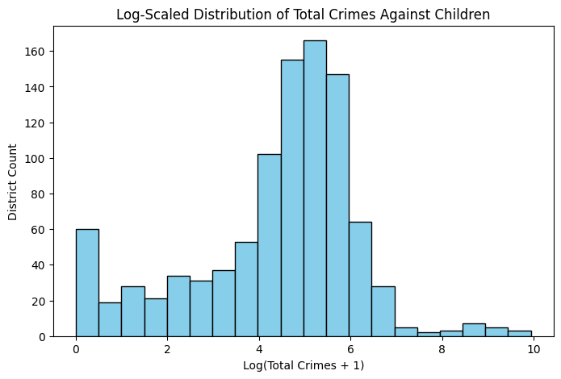
Distribution of Total Crimes Against Children
This histogram highlights the log-scaled distribution of total crimes against children, showing that most districts fall within moderate crime levels, while a few exhibit very high or very low counts. It is useful for understanding regional crime concentration, identifying outliers, and intervention planning.

Slide 8
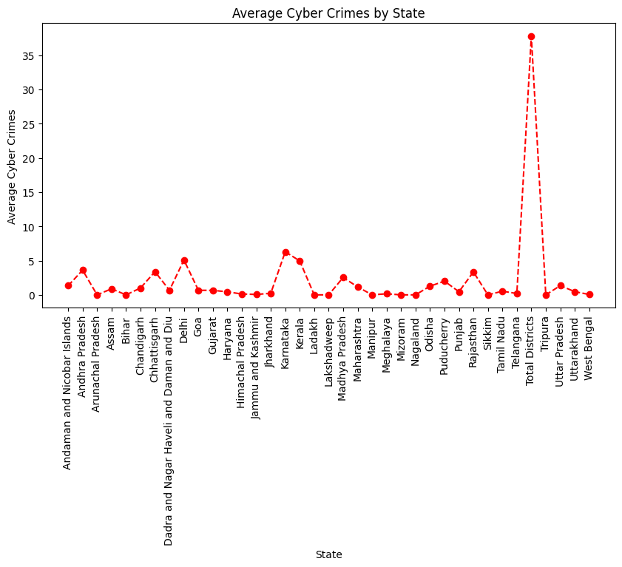
Average Cyber Crimes by State
This line plot illustrates the average number of cyber crimes across different states, highlighting regional variations in cyber-related offenses. Most states show relatively low averages, while a few, such as Telangana, display a significant spike, indicating a much higher incidence rate.

Slide 9
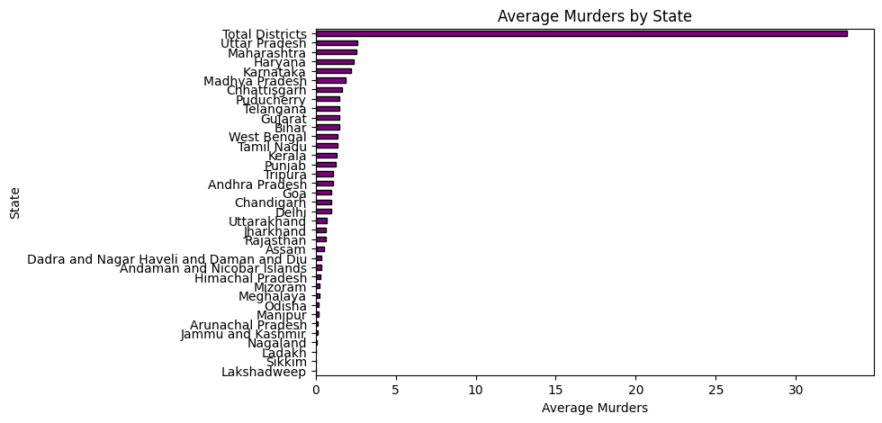
Average Number of Murders
The bar graph illustrates the average number of murders reported by different states in India. Uttar Pradesh, Maharashtra, and Haryana show comparatively higher averages, while many northeastern and smaller states report very low averages.

Slide 10
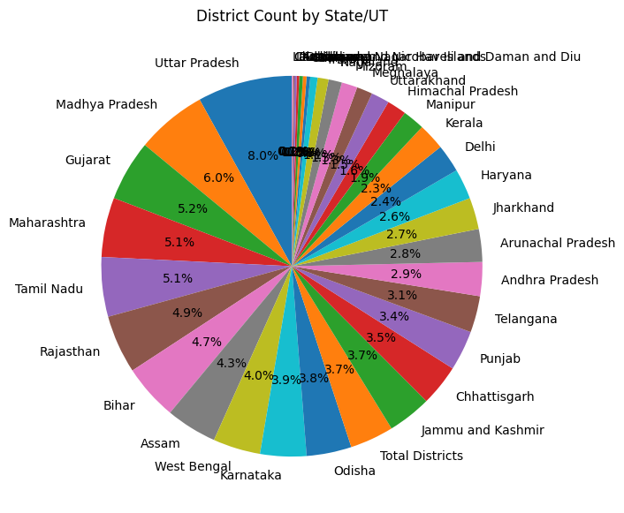
Employee Count By Department
The pie chart represents the distribution of districts across different states and union territories in India. Uttar Pradesh has the largest share with 8%, followed by Madhya Pradesh, Gujarat, Maharashtra, and Tamil Nadu contributing significant portions.

Slide 11
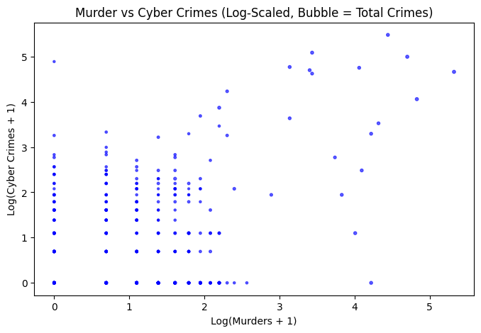
Murder vs Cyber Crimes
The graph shows the relationship between murders and cybercrimes using a log-scaled bubble chart, where bubble size represents the total number of crimes. Most data points cluster at lower values, indicating that many regions report relatively fewer murders and cybercrimes.

Slide 12
Dataset Observation
Crime Distribution
Crimes against children vary significantly across districts and states, with certain regions showing notably higher case counts. Urban districts tend to report more incidents, possibly due to better reporting mechanisms and population density. Some states show consistently high figures across multiple categories, indicating concentrated areas of concern.
Category-wise Insights
Specific crime types such as kidnapping and abduction, sexual offences, and child labour violations form the majority of reported cases. Neglect-related and other minor offences appear less frequent but may be underreported.

Slide 13
Dataset Observation
Temporal / Trend Patterns
Overall crime levels have shown gradual increases over recent years, highlighting growing awareness and reporting. Certain districts show sudden spikes, suggesting either isolated incidents or local enforcement drives. The trend analysis reveals a need for continuous monitoring and early-warning mechanisms in high-risk zones.
State-wise Representation
States like Maharashtra, Uttar Pradesh, Madhya Pradesh, and Bihar show higher total cases compared to smaller states or UTs. Northeastern and hilly regions generally report lower numbers, possibly due to smaller populations or reporting challenges.

Slide 14
Conclusion
The dataset provides detailed district- and state-wise records of crimes against children reported across India. It captures multiple crime categories, enabling comparison and pattern detection. Data shows wide variation among regions, reflecting demographic and reporting differences. Certain states consistently record higher case volumes, while others show minimal reports. Overall, the dataset offers a comprehensive snapshot of child-related offences, useful for analytical and policy research.

